Slide 1
Hadoop Data Types
Dr.Preethi Ananthachari
Asst.Professor
AI & Big Data Dept
Endicott College of International Studies
Woosong University

Slide 2
Data Types
Hadoop provides Writable interface based data types for serialization and de-serialization of data storage in HDFS and mapreduce computations.

Slide 3
Serialization
Serialization is the process of converting object data into byte stream data for transmission over a network across different nodes in a cluster or for persistent data storage.

Slide 4
Deserialization
Deserialization is the reverse process of serialization and converts byte stream data into object data for reading data from HDFS.
Hadoop provides Writables for serialization and deserialization purpose.

Slide 5
Writable/Writable Comparable
To provide mechanisms for serialization and deserialization of data, Hadoop provided two important interfaces Writable and
WritableComparable.

Slide 6
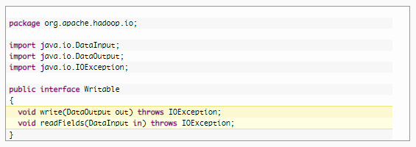
Writable interface specification

Slide 7

Writable Comparable
WritableComparable interface is sub-interface of Hadoop’s Writable and Java’s Comparable interfaces.

Slide 8

The standard java.lang.Comparable Interface contains single method compareTo() method for comparing the operators passed to it.
The compareTo() method returns -1 , 0 , or 1 depending on whether the compared object is less than, equal to, or greater than the current object.
The above two interfaces are provided in org.apache.hadoop.io package

Slide 9
Constraints on key-values in Mapreduce
Hadoop data types used in Mapreduce for key or value fields must satisfy two constraints.
Any data type used for a Value field in mapper or reducer input/output must implement Writable Interface.
Any data type used for a Key field in mapper or reducer input/output must implement WritableComparable interface along with Writable interface to compare the keys of this type with each other for sorting purposes.

Slide 10
Writable Classes
Hadoop provides classes that wrap the Java primitive types and implement the WritableComparable and Writable Interfaces.
They are provided in the org.apache.hadoop.io package.
All the Writable wrapper classes have a get() and a set() method for retrieving and storing the wrapped value.

Slide 11
Primitive Writable Classes
The Writable Wrappers for Java primitive data types hold a single primitive value that can be set either at construction or via a setter method.
All the primitive writable wrappers have get() and set() methods to read or write the wrapped value.

Slide 12
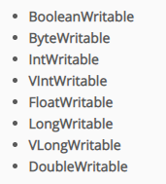
VIntWritable and VLongWritable are used for variable length Integer types and variable length long types respectively.
Serialized sizes of the above primitive writable data types are same as the size of actual java data type. So, the size of IntWritable is 4 bytes and LongWritable is 8 bytes.

Slide 13
Array Writable Classes
Hadoop provided two types of array writable classes, one for single-dimensional and another for two-dimensional arrays.
But the elements of these arrays must be other writable objects like IntWritable or LongWritable only but not the java native data types like int or float.
ArrayWritable
TwoDArrayWritable

Slide 14
Map Writable Classes
Hadoop provided below MapWritable data types which implement java.util.Map interface
AbstractMapWritable – This is abstract or base class for other MapWritable classes.
MapWritable – This is a general purpose map mapping Writable keys to Writable values.
SortedMapWritable – This is a specialization of the MapWritable class that also implements the SortedMap interface.

Slide 15
Other Writable classes
NullWritable is a special type of Writable representing a null value. No bytes are read or written when a data type is specified as NullWritable. So, in Mapreduce, a key or a value can be declared as a NullWritable when we don’t need to use that field.
ObjectWritable is a general-purpose generic object wrapper which can store any objects like Java primitives, String, Enum, Writable, null, or arrays.

Slide 16
Text can be used as the Writable equivalent of java.lang.String and It’s max size is 2 GB. Unlike java’s String data type, Text is mutable in Hadoop.
BytesWritable is a wrapper for an array of binary data.
GenericWritable is similar to ObjectWritable but supports only a few types. User need to subclass this GenericWritable class and need to specify the types to support.

Slide 17
Example Program
import org.apache.hadoop.io.* ;
import java.util.* ;
public class WritablesTest
{
public static class TextArrayWritable extends ArrayWritable
{
public TextArrayWritable()
{
super(Text.class) ;
}
}
public static class IntArrayWritable extends ArrayWritable
{
public IntArrayWritable()
{
super(IntWritable.class) ;
}
}

Slide 18
public static void main(String[] args)
{
IntWritable i1 = new IntWritable(2) ;
IntWritable i2 = new IntWritable() ;
i2.set(5);
IntWritable i3 = new IntWritable();
i3.set(i2.get());
System.out.printf("Int Writables Test I1:%d , I2:%d , I3:%d", i1.get(), i2.get(), i3.get()) ;
BooleanWritable bool1 = new BooleanWritable() ;
bool1.set(true);

Slide 19
ByteWritable byte1 = new ByteWritable( (byte)7) ;
System.out.printf("\n Boolean Value:%s Byte Value:%d", bool1.get(), byte1.get()) ;
Text t = new Text("hadoop");
Text t2 = new Text();
t2.set("pig");
System.out.printf("\n t: %s, t.legth: %d, t2: %s, t2.length: %d \n", t.toString(), t.getLength(), t2.getBytes(), t2.getBytes().length);
ArrayWritable a = new ArrayWritable(IntWritable.class) ;
a.set( new IntWritable[]{ new IntWritable(10), new IntWritable(20), new IntWritable(30)}) ;
ArrayWritable b = new ArrayWritable(Text.class) ;
b.set( new Text[]{ new Text("Hello"), new Text("Writables"), new Text("World !!!")}) ;

Slide 20
for (IntWritable i: (IntWritable[])a.get())
System.out.println(i) ;
for (Text i: (Text[])b.get())
System.out.println(i) ;
IntArrayWritable ia = new IntArrayWritable() ;
ia.set( new IntWritable[]{ new IntWritable(100), new IntWritable(300), new IntWritable(500)}) ;
IntWritable[] ivalues = (IntWritable[])ia.get() ;
for (IntWritable i : ivalues)
System.out.println(i);
MapWritable m = new MapWritable() ;
IntWritable key1 = new IntWritable(1) ;
NullWritable value1 = NullWritable.get() ;

Slide 21
m.put(key1, value1) ;
m.put(new VIntWritable(2), new LongWritable(163));
m.put(new VIntWritable(3), new Text("Mapreduce"));
System.out.println(m.containsKey(key1)) ;
System.out.println(m.get(new VIntWritable(3))) ;
m.put(new LongWritable(1000000000), key1) ;
Set<Writable> keys = m.keySet() ;
for(Writable w: keys)
System.out.println(m.get(w)) ;
}
}

Slide 22
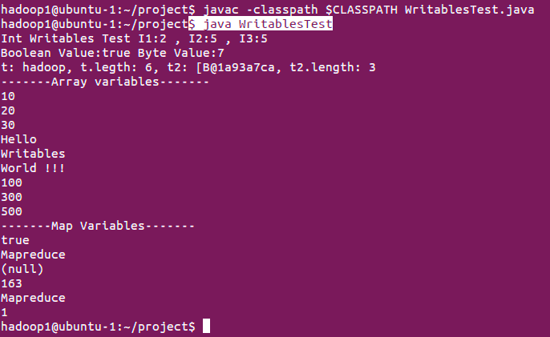
Results

